Slide 1
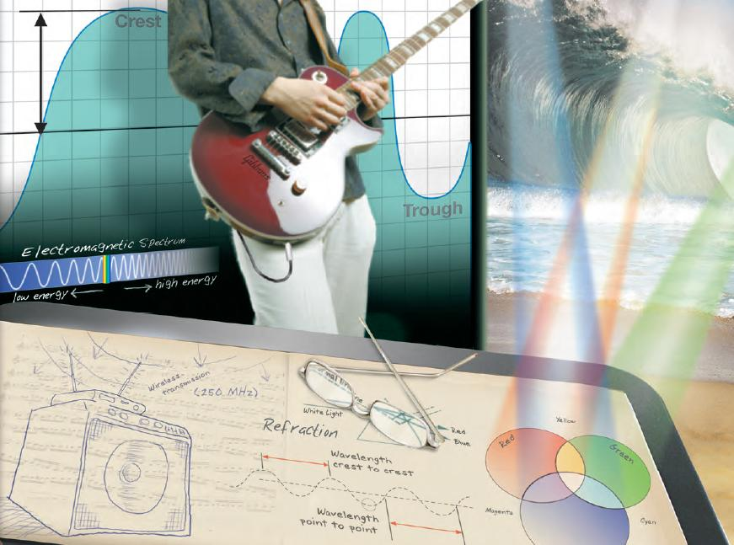
Unit 12: Waves
Waves

Slide 2
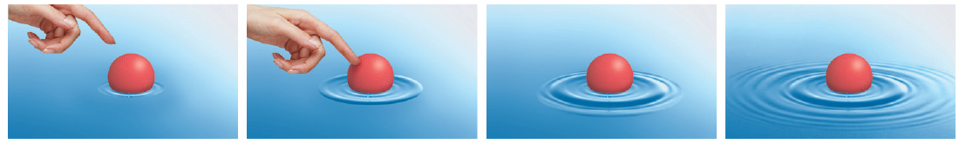
What is a wave?
Wave – a disturbance that travels from one place to another

Slide 3
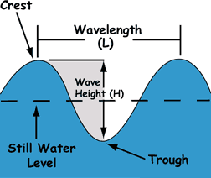
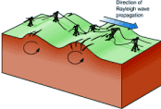

What is a medium?
Medium – the material through which a wave
travels
When a wave travels through a medium, it transfers energy
Air
Water
Earth

Slide 4
Parts of a Wave
Amplitude (A)– the maximum height a wave rises above or below the surface position; a representation of its energy; measured in meters, [m].

Slide 5
Parts of a Wave
Wavelength (λ)– the distance from one point on a wave to the same exact point on the next cycle of the wave; measured in meters, [m].

Slide 6
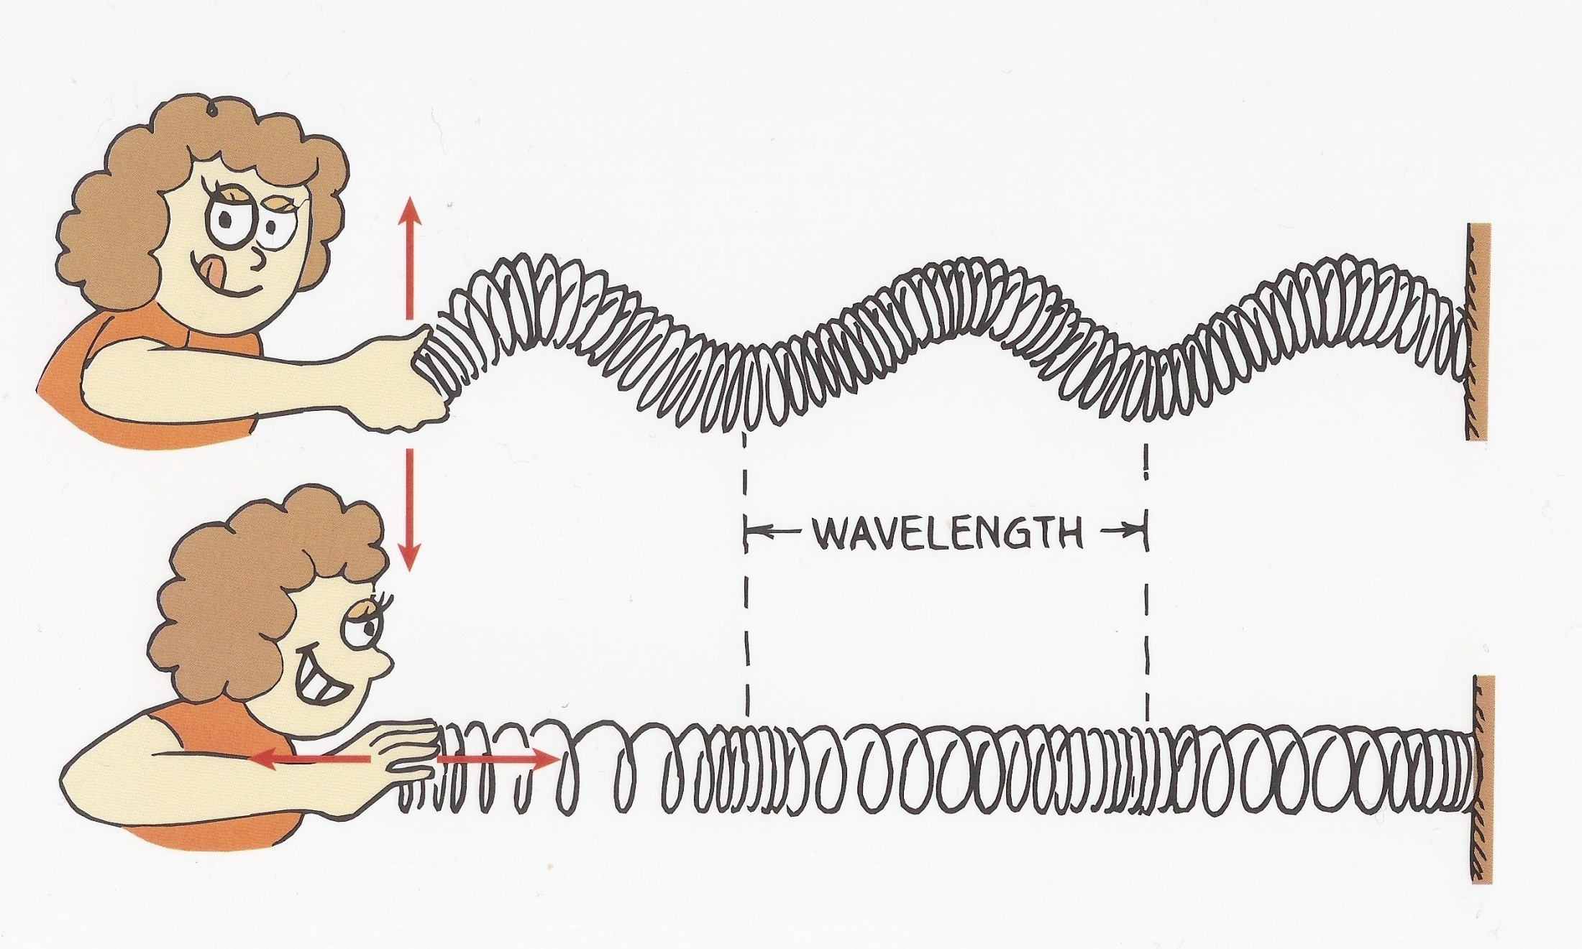

Slide 7
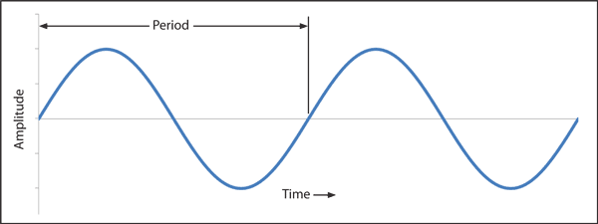
Parts of a Wave
Period (T)– the time, in seconds, it takes for one full cycle (wavelength) of a wave to pass a point.

Slide 8
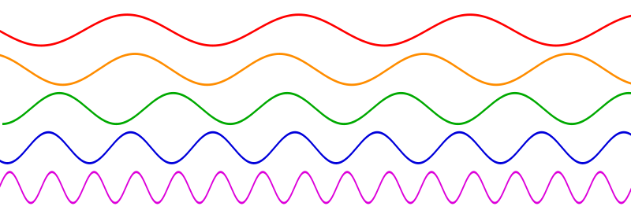
Parts of a Wave
Frequency (f) – how many full cycles pass a point in one second, measured in units of Hertz [Hz]. The frequency is one over the period of the wave.

Slide 9
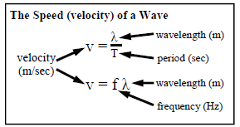
Parts of a Wave
Speed (v)– how fast one wavelength travels in one period of time; measured in meters per second [m/s]

Slide 10
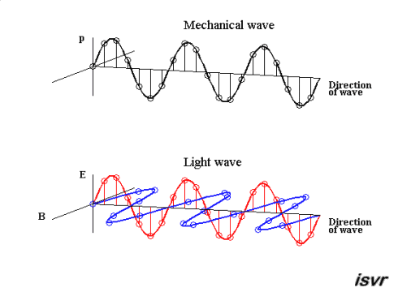
Two Types of Waves
Mechanical Waves – require a medium to go through (Can be transverse or longitudinal)
Electromagnetic Waves – do NOT require a medium to go through (All are transverse)

Slide 11
Types of Mechanical Waves
Water waves
Earthquake/seismic waves
Sound waves
Waves that travel down a rope or spring
Notes:
All of these examples CANNOT move through empty space.

Slide 12
Types of Electromagnetic Waves
Radio waves
Microwaves
Infrared waves
Visible light
Ultraviolet rays
X-rays
Gamma Radiation
Notes:
All of these examples CAN move through empty space.

Slide 13
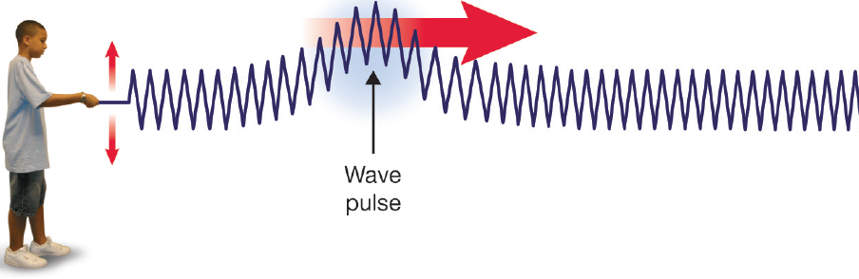
Types of Waves
Transverse Wave – A mechanical or electromagnetic wave where the oscillations are perpendicular to the direction that the wave moves

Slide 14
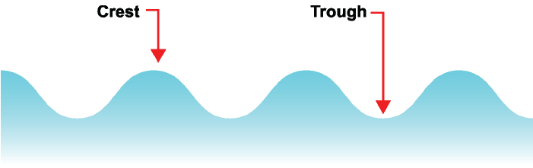
Parts of a Transverse Wave
Crest – the high point of the wave
Trough – the low point of the wave

Slide 15
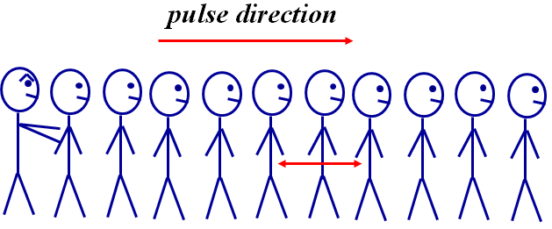
Types of Waves
Longitudinal Wave – A mechanical wave where the oscillations are parallel to the direction that the wave moves

Slide 16
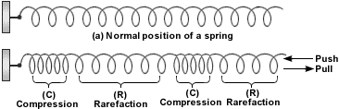
Parts of a Longitudinal Wave
Rarefaction – area of a longitudinal wave that is spread out, low pressure
Compression – area of a longitudinal wave that is close together, high pressure

